Slide 1

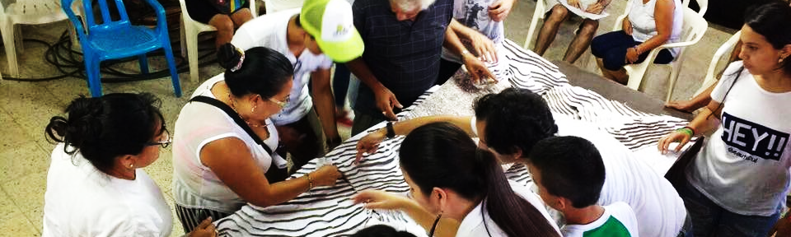
Reconstruction and Recovery for Displaced Populations and Refugees
Reducing the Vulnerability of Internally Displaced Populations through Tactical Urbanism: A Case of Research and Implementation in Colombia
Stefania Arango Cuartas, Gonzalo Lizarralde, Benjamin Herazo, Adriana López.
Notes:
Good afternoon, first I want to introduce myself, my name is Stefania Arango Cuartas, I am an architect and student of the architecture and urbanism master from Universidad del Valle in Colombia.
I apologize in advance for any mistake I may make with my English.
Today I will present you my research work Reducing the Vulnerability of Internally Displaced Populations through Tactical Urbanism: A Case of Research and Implementation in Colombia

Slide 2




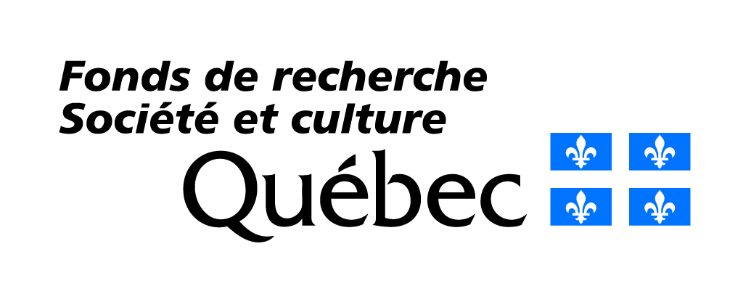

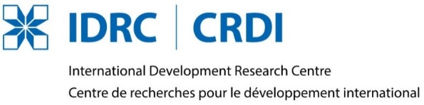

Œuvre Durable
Observatoire universitaire de la vulnérabilité, la résilience et la reconstruction durable
The Disaster Resilience and Sustainable Reconstruction Research Alliance
www.grif.umontreal.ca/observatoire/
Notes:
This work is framed in the research internship that I am doing now with the University of Montreal involved with the Grif group and The Disaster Resilience and Sustainable Reconstruction Research Alliance

Slide 3

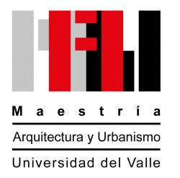
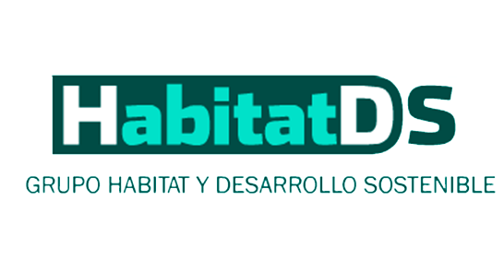
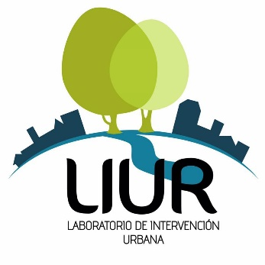
Topics
1
Research Objective
IDPs in Colombia in a worldwide perspective
Vulnerabilities among IDPs
Opportunities of Tactical Urbanism for Creating Green Infrastructure
Yumbo River Case Study
Discussion
2
3
4
5
6
Notes:
This presentation will develop five topics in which the research work has been framed.

Slide 4
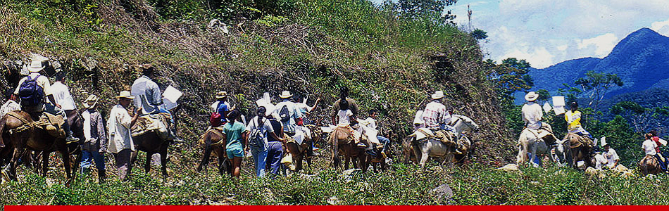
1. Research Objective
Colombia is the second country with the highest number of internally displaced population worldwide, who are more vulnerable due to their living conditions. This research studies tactical urbanism strategies and green infrastructure tools to reduce the IDPs vulnerability to flood risks.
MIGRATION OF IDPS IN COLOMBIA
Taken from: http://www.semana.com/nacion/articulo/desplazamiento-colombia-es-el-pais-con-mas-desplazados-en-latinoamerica/387275-3
Notes:
The research objective submits that Colombia is the second country with the highest number of internally displaced population worldwide by conflict, who are more vulnerable due to their living conditions.
This research and implementation project examines the advantages of tatical urbanism as a way to: (a) reduce the vulnerability of this displaced population, (b) implement green infrastructure to mitigate natural hazards, and (c) protect the ecosystem while producing social benefits.

Slide 5
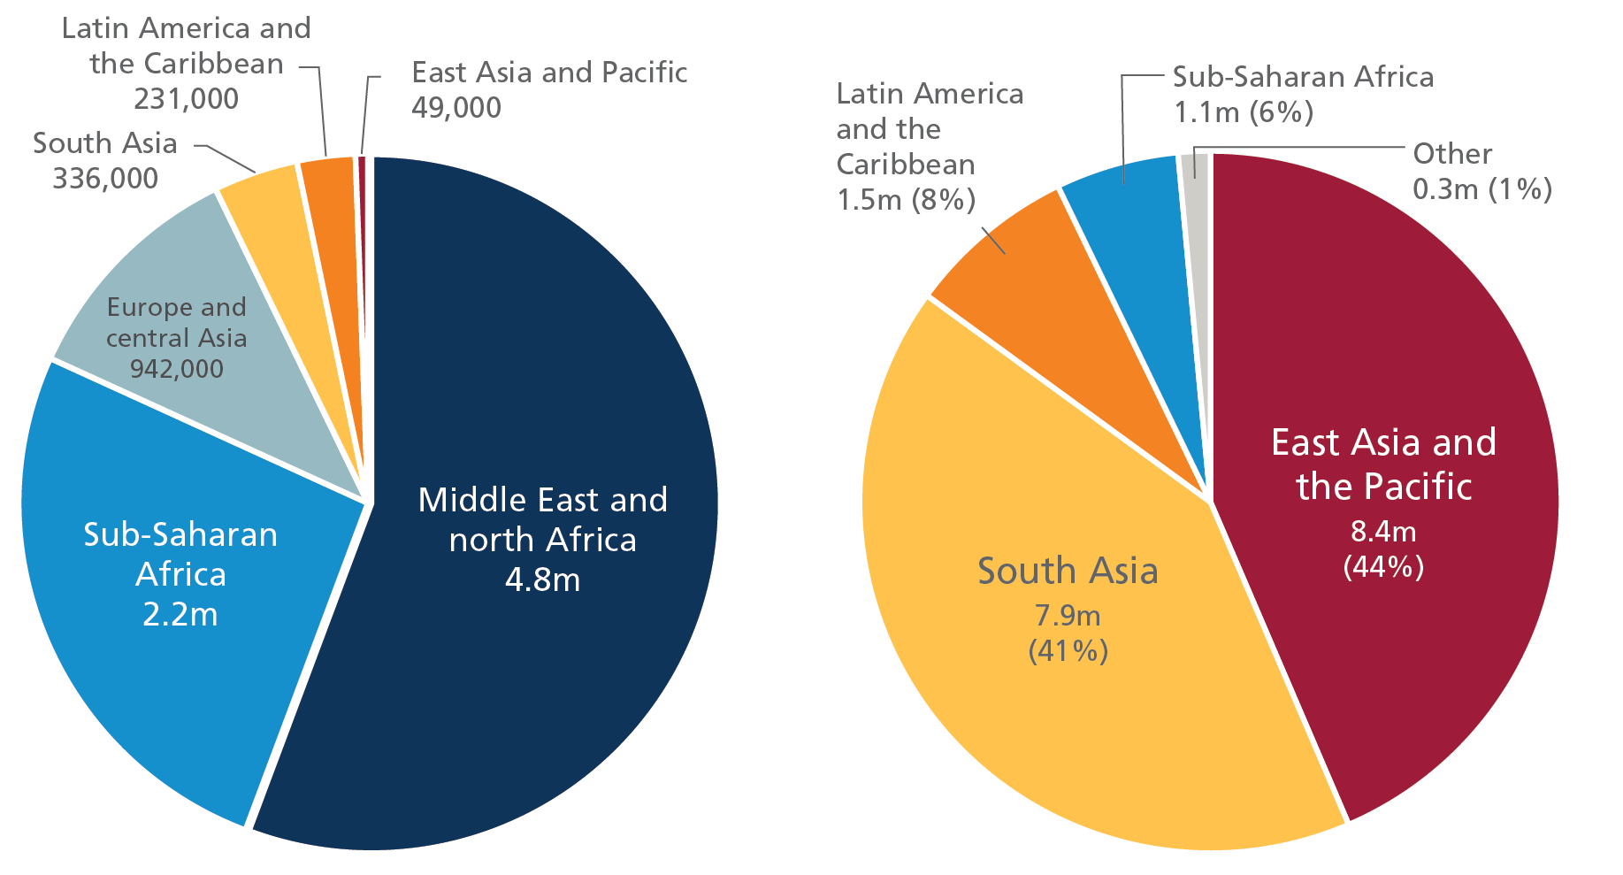
2. IDPs in Colombia in a worldwide perspective
Internal Displacement Monitoring Centre (IDMC) counted 8,6 million new IDPs by conflict and 19,2 million new IDPs by disasters in 2015.
Colombia had 224,000 new IDPs per conflict of the 231,000 that were reported throughout Latin America and the Caribbean for the same year.
(Bilak et al., 2016)
REGIONS WITH MOST NEW DISPLACEMENT IN 2015
Taken from: http://www.internal-displacement.org/globalreport2016/
Notes:
In 2015 official figures from the INTERNAL DISPLACEMENT MONITORING CENTRE SHOW new IDPs by natural threats and disasters were 19,2 million people, while new IDPs due to conflict and wars were 8,6 million people, of which 224.000 belong to Colombia 97% of the total for the Latin America and the Caribbean

Slide 6
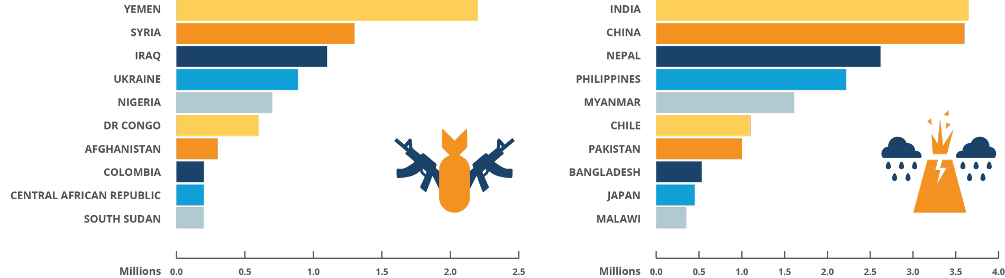
2. IDPs in Colombia in a worldwide perspective
Colombia was the only country in Latin America and the Caribbean which is in the top 10 with more quantity of new IDPs in 2015 worldwide.
(Bilak et al., 2016)
CONFLICT DISASTER
COUNTRIES WITH MOST NEW DISPLACEMENT IN 2015
Taken from: http://www.internal-displacement.org/globalreport2016/
Notes:
As result Colombia was the only country in Latin America and the Caribbean which is in the top 10 with more quantity of new IDPs by conflict in 2015 worldwide.

Slide 7
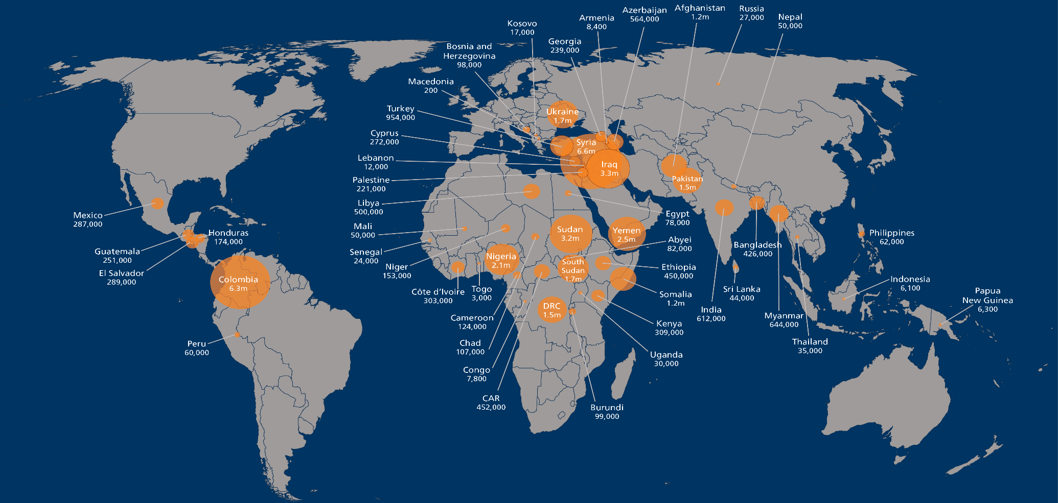
2. IDPs in Colombia in a worldwide perspective
According with IDMC the total worldwide IDPs by conflict is 40,8 million people, whereof Colombia has more than 6 million at 2015.
(Bilak et al., 2016)
Colombia
6.3m
PEOPLE INTERNALLY DISPLACED AS A RESULT OF CONFLICT AND VIOLENCE AS OF 31 DECEMBER 2015
Taken from: http://www.internal-displacement.org/globalreport2016/. Modified by the autor.
Notes:
IDPs due to conflict in Colombia exceed the 6million people, positioning Colombia as the second country only with Syria ahead. Concentrating more than 15% of the world total.
In Its specific case with 48 million inhabitants is equivalent to 13% of the Colombian total population
Displacement in Colombia is mostly caused by the 50-year-old armed conflict between Marxist guerrillas, extreme-right militias, and the government
The most affected sector is composed by Afro-Colombians and indigenous communities. The largest social groups in poverty
These conditions push entire families into rural-urban migration, and most of them become part of the population “in (a) state of poverty”, which in Colombia reached 28% of the total population in 2016.

Slide 8
3. Vulnerabilities among IDPs
Vulnerability is the characteristic of a person or group of people, which makes them unable to anticipate, survive, resist, and recover from the impact of a natural hazard or shock. (Blaikie, Cannon, David, & Wisner, 1996)
IDPs Vulnerability
Economic factors
Environmental Characteristics
Social factors
Political factors
Historic characteristics of population
Unsuitable areas
Fragile structures
Without quality infrastructure
Insecurity areas
Weak community organization
Unequal distribution of public resources
Lack of urban planning
Disconnected to public procedures
Previous events suffered
Natural hazards
Transformations in territory over time
Causes
Consequences
CAUSES OF VULNERABILITIES AMONG IDPS
Prepared by the authors based on (Blaikie, Cannon, David, & Wisner, 1996)
Notes:
Vulnerability is created by the sum of economic, social and political factors, and historic characteristics that influence the living conditions of social groups. It is also the result of spatial and temporal transformations in nature and the built environment. These factors determine the possible social, material, and psychological losses that individuals or groups can suffer in the face of threats.
Economic factors include their location in the cities, which is often in informal or in illegal settlements situated in unsuitable areas, the quality of construction with houses built with fragile materials and without proper foundations. And the insufficient access to urban services, infrastructure, and public spaces
Political factors are related to the widespread lack of interest by governments on providing solutions for the poor. There is often an unequal distribution of public resources, coupled with a lack of urban planning and development and the non-execution of infrastructure capable of mitigating hazards and reducing disaster risks.
Social factors include exposure to crime and illegal activities, little or no community organization, weak relationship with government and public processes, scant spaces of participation in project development, and the frequent fragmentation of groups by cultural conditions.

Slide 9
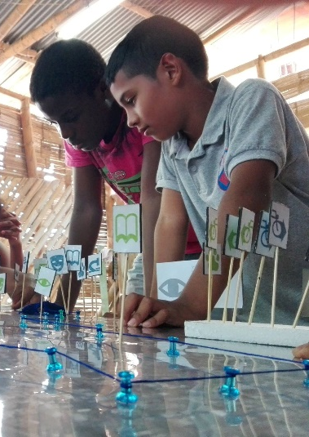
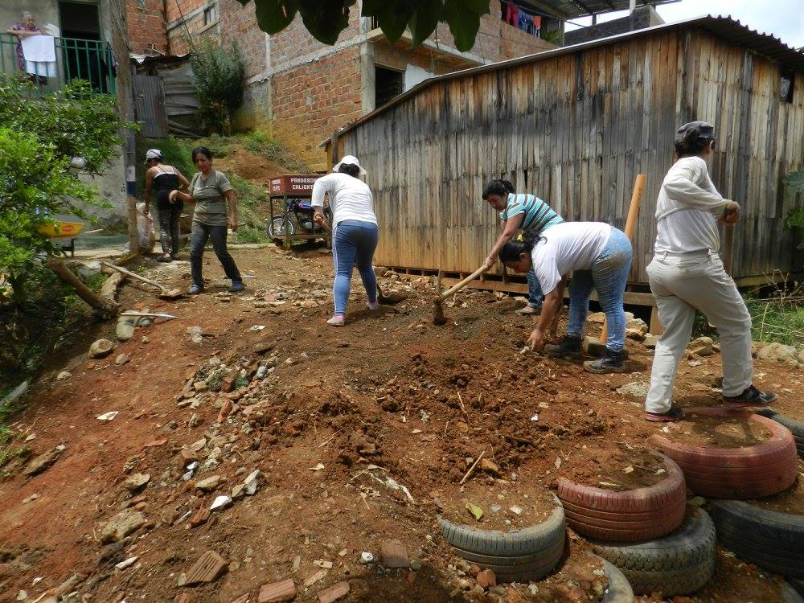
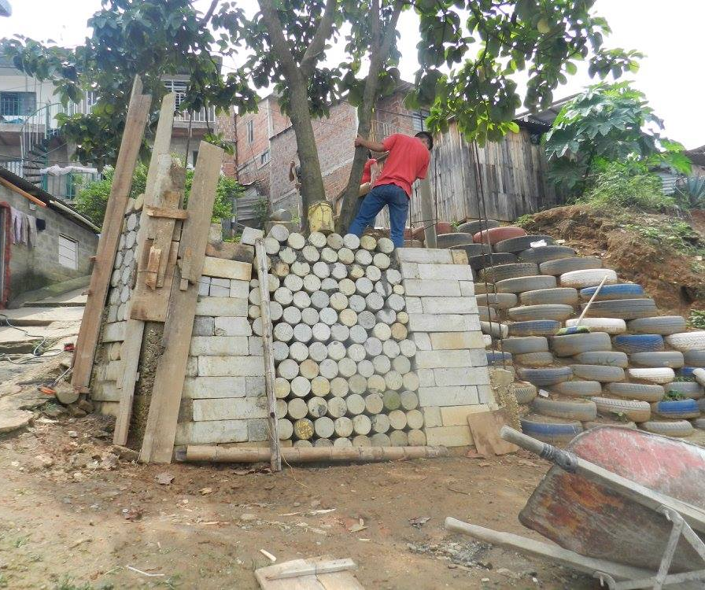
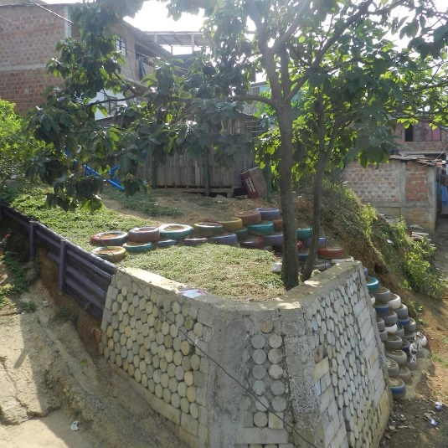
4. Opportunities of Tactical Urbanism for Creating Green Infrastructure
TACTICAL URBANISM
Myke Lydon, urbanist creator of the term, attributes "the new wave of tactical projects" to three recent and coincident events:
  Economic recession
  Demographic changes
  The Internet
(Steffens, Garcia, Vergara, Lydon, & Khawarzad, 2013)
Main Characteristics
Short-term actions for long-term change
Low cost projects
Small-scale actions
Community-led, according with their necessities
Bottom-up model
Applied to public space
Self-managed projects
Easily replicable actions
Physical and social connections
Works with the existing thing in the space
ESE PARK LEAD BY ARCHITECTURE STUDENTS FROM UNIVERSIDAD DEL VALLE. CALI,COLOMBIA
https://www.facebook.com/somosladera/
Notes:
Tactical urbanism strategies are increasingly seen as a way ato reduce community vulnerability. This approach argue that they help create solutions aboving the traditional planning processes or top-down models which take years to implement a Project, that in several cases it does not meet the needs of the local communities
This term was created by the urbanist Myke Lydon, who gives its methodology and theoretical foundations. He attributes the new wave of tactical projects to
Economic recession (With creativity to do things)
Demographic changes (With more problems in the cities to solve)
The Internet (As a quick and easy way of knowledge)
Tactical urbanism is a new model for building a city, where the inhabitants of the city take control of the decisions to be made, determining what and how it is going to be build, according with their social, cultural and biological determinants, which contribute with unique values to live the space.
The main characteristics are: Short-term actions for long-term change; Low cost projects; Small-scale actions
The project below was developed by architecture students from Universidad del Valle in Cali, them along with Urban Intervention Laboratory led a TU project with a poor community in Cali, from social mapping and recognition of the place to management and construction an intervention that resulted in a new public space for this Poor hillside community.

Slide 10
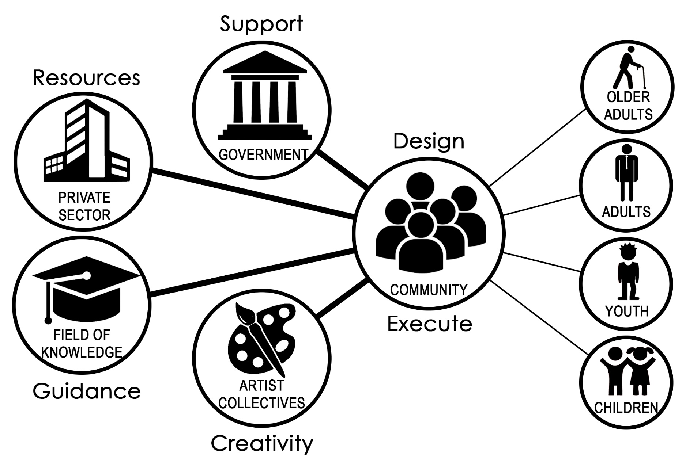
4. Opportunities of Tactical Urbanism for Creating Green Infrastructure
STAKEHOLDERS INVOLVED IN TACTICAL URBANISM PROJECTS
Prepared by the authors based on (Pírez, 1995; Lydon & Garcia, 2015)
Notes:
In TU projects Five social actors or stakeholders are identified, the main one is the community, the other four can or do not appear in the process.
Government: gives technical and economic solutions.
Private Sector: provides economic, material or human resources
Field of Knowledge: provides knowledge and support to guide the process.
Artist Collectives: builds creative work with community
All these stakeholders act through their relationship with the community who is empowered to make a participatory design and a community building of the public space
Likewise the community is divided according to population groups by age, which must be considered to know their different needs and the possibility of contributing to the intervention from their capacities.

Slide 11
4. Opportunities of Tactical Urbanism for Creating Green Infrastructure
“Tactical urbanism can be a game-changing approach to green infrastructure. It provides support, resources, and opportunities to help diverse communities reconnect places with their cultural and environmental contexts”.
(Leonard, 2015)
Tactical Urbanism Strategies
Faster way to apply a project
With community participation
IDPs Vulnerability
Strengthening links between community and territory
Reducing risk
and adapted to the territory
Green Infrastructure Tools
With social and ecological benefits
Solutions to mitigate natural hazards
Applying
To reduce
JUSTIFICATION AND EXISTING RELATIONS
Prepared by the authors based on ((Leonard, 2015; Conde & Saldaña, 2007)
Notes:
TU strategies applying GI tools can reduce IDPs Vulnerability, creating short-term projects that solve the needs of this population in the public space, while reducing risks by the natural hazards that affect them and improving the environment where they develop all their social activities. Also a better image of the space changes the perception of the community and its relationship with it, and can be a pilot project appropriated and replicated by the municipality which create a wider network with better results.

Slide 12
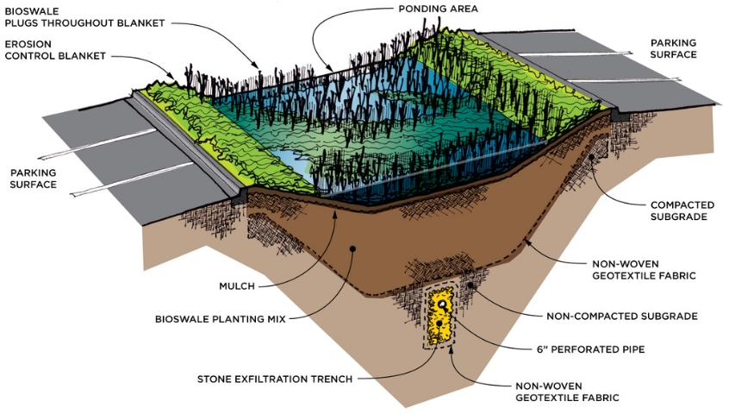
4. Opportunities of Tactical Urbanism for Creating Green Infrastructure
GREEN INFRASTRUCTURE
Ecological Benefits
Climate regulation
Reduce water and air pollution
Noise reduction
Shelter of native species
Mitigation and adaptation to climate change
Increases and protects biodiversity
Reduction to flood risks
Restores ecosystems
Social Benefits
Space for recreation
Better energy consumption of buildings
Psychological well-being
Increases life expectancy
Increases physical activity levels
Improves the health of the population
Mobility corridors
Improves social and territorial cohesion
Long term economic benefits
(Benedict & McMahon, 2006)
(Jones & Somper, 2014)
(Lafortezza, Davies, Sanesi, & Konijnendijk, 2013)
(Liu, Chen, & Peng, 2014)
GREEN INFRASTRUCTURE SYSTEM
Taken from: ttps://es.pinterest.com/pin/451978512574780947/
Notes:
Green infrastructure implements ecosystem services in urban planning as an environmentally friendly way of restoring lost ecological cycles due to the traditional expansion of cities.
Unlike gray infrastructure, which only deals with solving one problem, green infrastructure offers multiple ecological and social benefits, with the green spaces implementation, which mitigate and adapt cities to climate change, while providing public space For Community activities.
Ecological benefits Highlight the importance of restoring ecological cycles, improving the environment and the biodiversity of fauna and flora.
Social benefits range from the tangible, such as drinking water or recreation spaces, to intangibles, such as the sensations nature gives people.

Slide 13
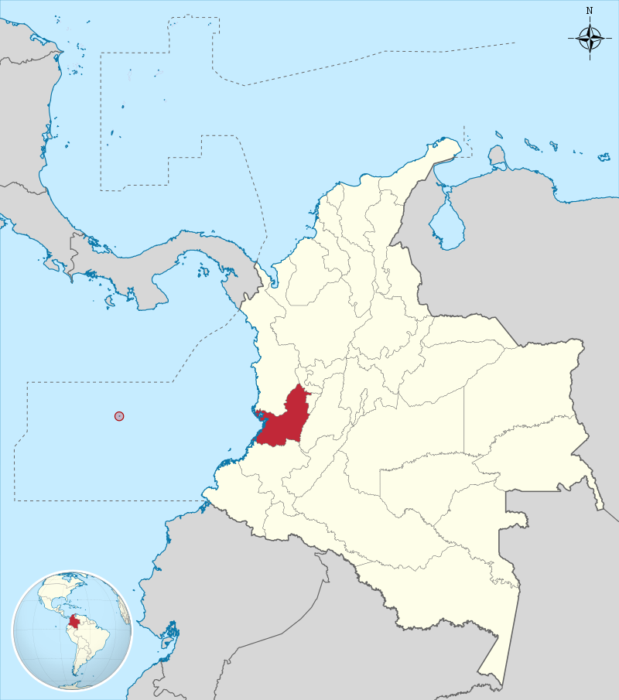
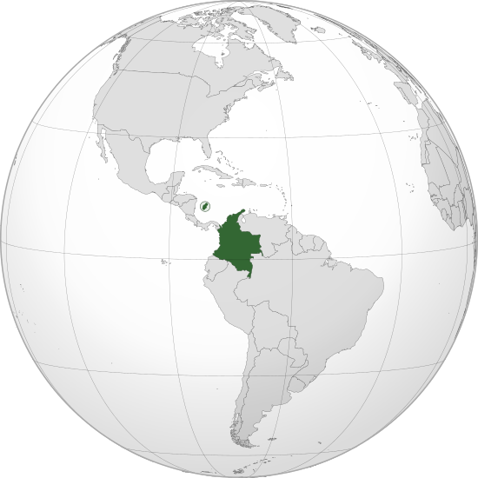
5. Yumbo River Case Study
VALLE DEL CAUCA DEPARTMENT INSIDE COLOMBIA
Taken from: https://es.wikipedia.org/wiki/Valle_del_Cauca
COLOMBIA POSITION IN THE WORLD
Taken from: https://es.wikipedia.org/wiki/Colombia
Notes:
The case study that was selected is in the country of Colombia, in the northwest of South America. Exactly in Valle del Cauca department located in the western side of the Colombia

Slide 14
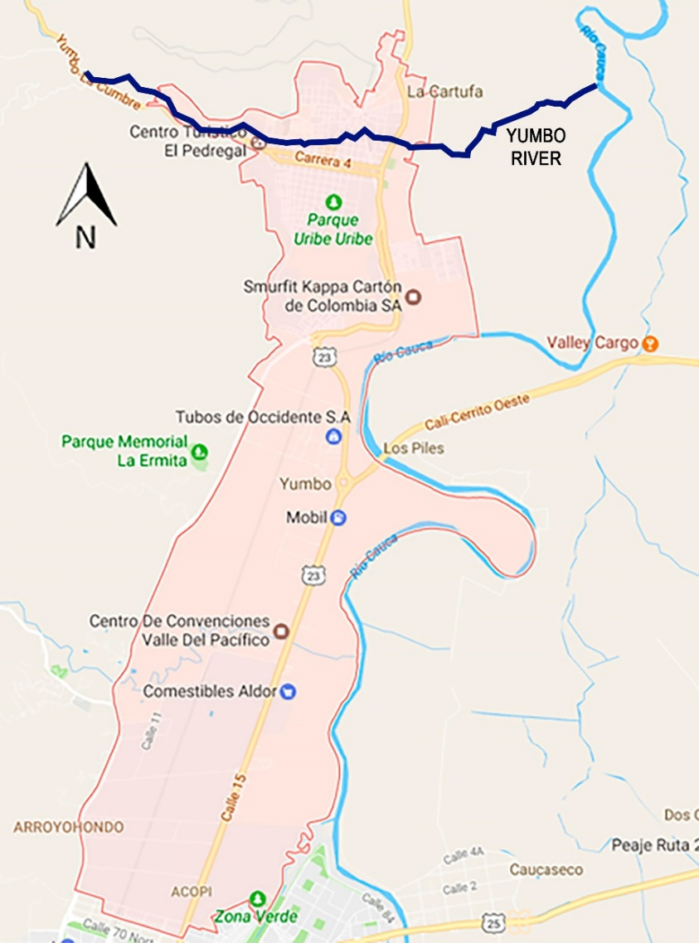
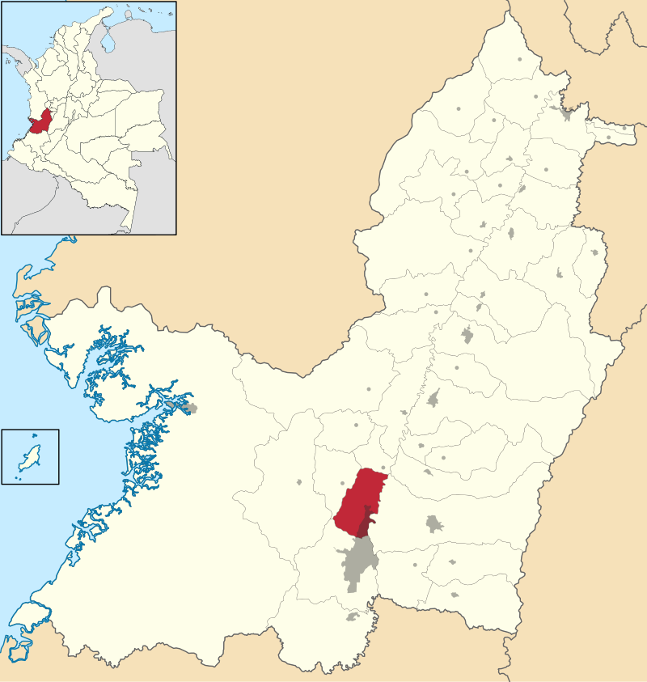
5. Yumbo River Case Study
Valle del Cauca department
Yumbo Urban Perimeter
Yumbo
Cali, capital of the Valle del Cauca
YUMBO CITY INSIDE VALLE DEL CAUCA DEPARTMENT
Taken from: https://es.wikipedia.org/wiki/Yumbo
VALLE DEL CAUCA DEPARTMENT INSIDE COLOMBIA
Prepared by the authors based on Google Maps
Notes:
Yumbo city is next and is part of the metropolitan area of Cali, the most important city in the region.
Its main economic activity is heavy industry, which attracts large numbers of migrant populations seeking job opportunities, including IDPs
Yumbo’s population in 2016 overpased 119,000 inhabitants from which at least 8,500 people, equivalent to the 7% of the total population are formally registered IDPs

Slide 15
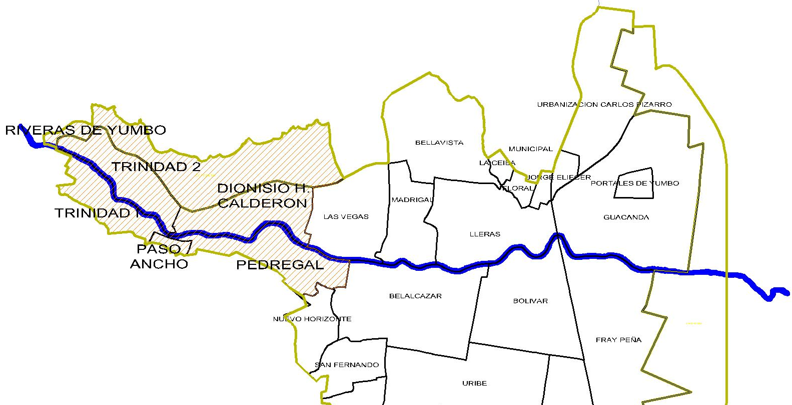
5. Yumbo River Case Study
NEIGHBORHOODS WITH IDPs SETTLEMENTS
Prepared by the authors based on (Becerra & Cortés, 2006)
Notes:
The flatlands occupied by large industries and harsh economic conditions have forced IDPs to create illegal settlements In the upper part of the Yumbo River, located in the neighbourhoods highlighted.
Yet their main causes of vulnerability remain. Construction on unstable and seep land on soil that is frequently saturated with water is frequent. Constructions are often made with wobbly material, without foundations, and without disaster-resistant standards. Neighborhoods still have inadequate public services, transportation routes, and public spaces;

Slide 16
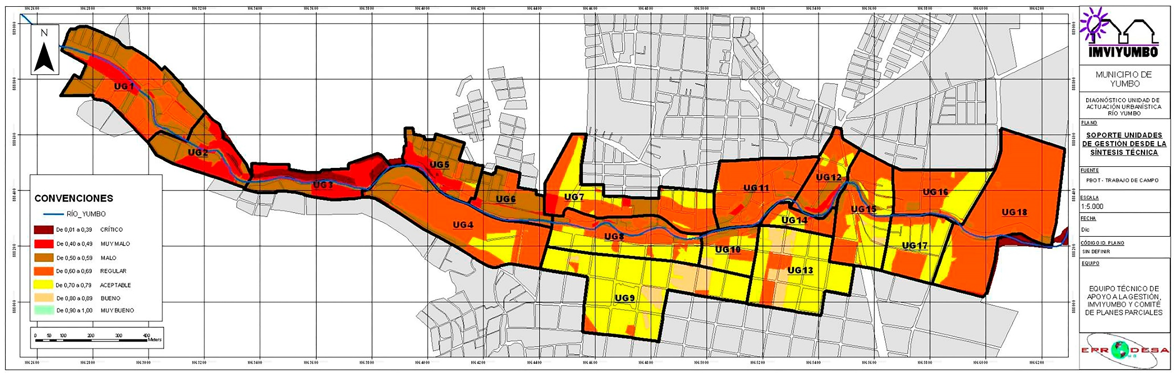
5. Yumbo River Case Study
VULNERABILITY WITHIN THE UNIT OF ACTION OF THE RIVER YUMBO
Taken from: (IMVIYUMBO, 2008)
Notes:
Taken from the study of IMVIYUMBO, municipal entity of the Yumbo city, this is the vulnerability identified within the area of influence of the Yumbo river
The red and brown colors belong to the most vulnerable areas, while the yellow ones represented the less vulnerable
With this we can identify as the most vulnerable the western part of the river.

Slide 17
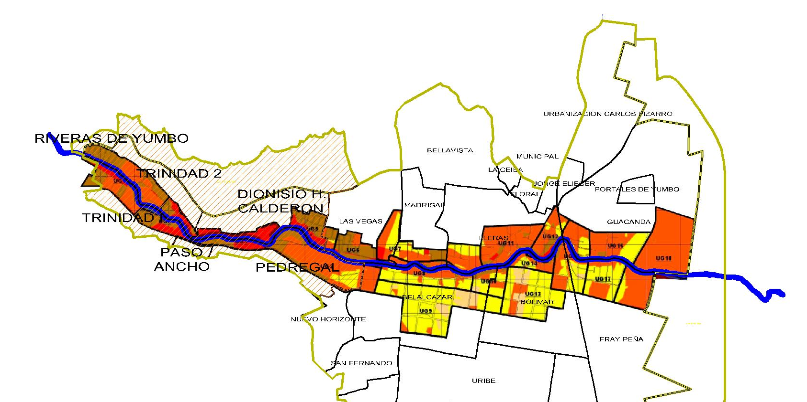
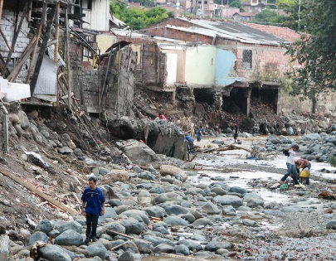
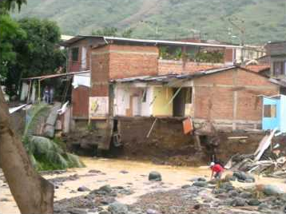
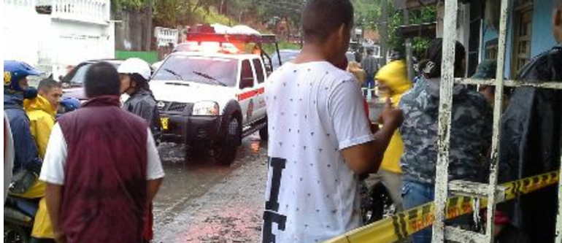
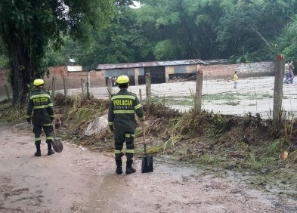
5. Yumbo River Case Study
NEIGHBORHOODS WITH IDPs SETTLEMENTS
Prepared by the authors based on (Becerra & Cortés, 2006; IMVIYUMBO, 2008)
Notes:
Overlapping both images it is found that the most vulnerable area historically has suffered flood events, the last one in April of this year, affecting IDPs families that are located there.
For this reason these neighborhoods, mainly La trinidad and Dionisio Calderón, are proposed as locations that have a greater potential to reduce risks among the IDP through GI applied by TU
For which it is necessary to advance in the study of the territory and in the reinforcement of the community links

Slide 18
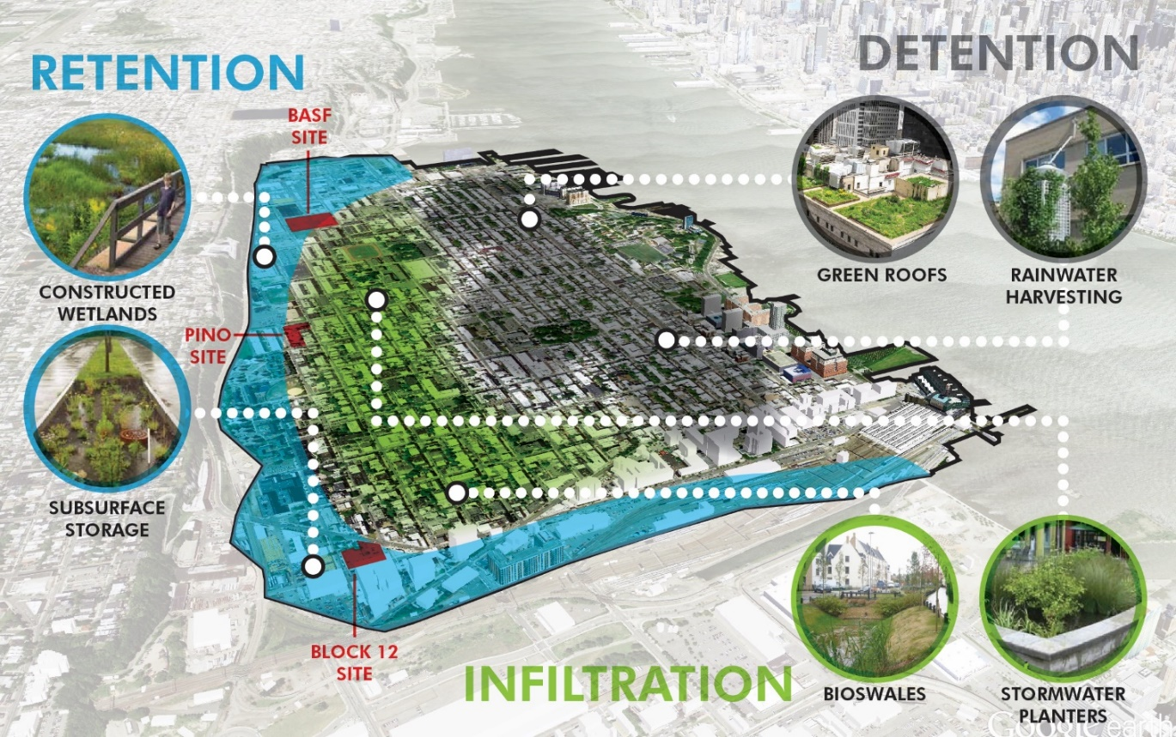
6. Discussion
IDPs are frequently forced to settle in hazard-prone areas
The participation of IDPs in the public processes in Colombia and other countries is scarce
This participation is crucial to reduce vulnerabilities.
TU can potentially help reduce IDP vulnerabilities
There is a potential to mitigate flood risks with the implementation of GI
More studies on this subject are still required to provide comprehensive solutions to IDP communities living in conditions of extreme vulnerability in Colombia.
GREEN INFRASTRUCTURE STRATEGY FOR THE CITY OF HOBOKEN
Taken from: http://togethernorthjersey.com/?grid-portfolio=hoboken-green-infrastructure-strategic-plan
Notes:
Finally and to conclude IDPs are frequently forced to settle in hazard-prone areas with unfavorable living conditions, rendering them vulnerable to disaster risk such as floods. The participation of IDPs in the public processes in Colombia and other countries is scarce; yet this participation is crucial in empowering IDPS, in producing sustainable change and in reducing vulnerabilities in informal settlements in Colombia. TU can potentially help reduce IDP vulnerabilities. Yet various stakeholders must be involved in order to generate social and environmental change in the region. In the case of the IDPs settled along the Yumbo river, there is a potential to mitigate flood risks with the implementation of GI. More studies on this subject are still required to provide comprehensive solutions to IDP communities living in conditions of extreme vulnerability in Colombia.

Slide 19
THANK YOU!
For any question or comment.
Stefania Arango Cuartas
stefania.arango@correounivalle.edu.co
Notes:
Thank you very much for your attention, any question or comment can write me to the mail on screen.
And now I am available to answer any doubt.

